Slide 1
Project D
Vakar & Yavuz

Slide 2
Table of contents
The problem
The request from Viscon
Project scope & features
Technology stack
Design & development
Demonstration
Future enhancements
What we improved on
Lessons learned
Conclusion

Slide 3

The problem
Packages get lost in warehouse

Slide 4

The request from Viscon
Prototype
AR application
a "nice-to-have"

Slide 5
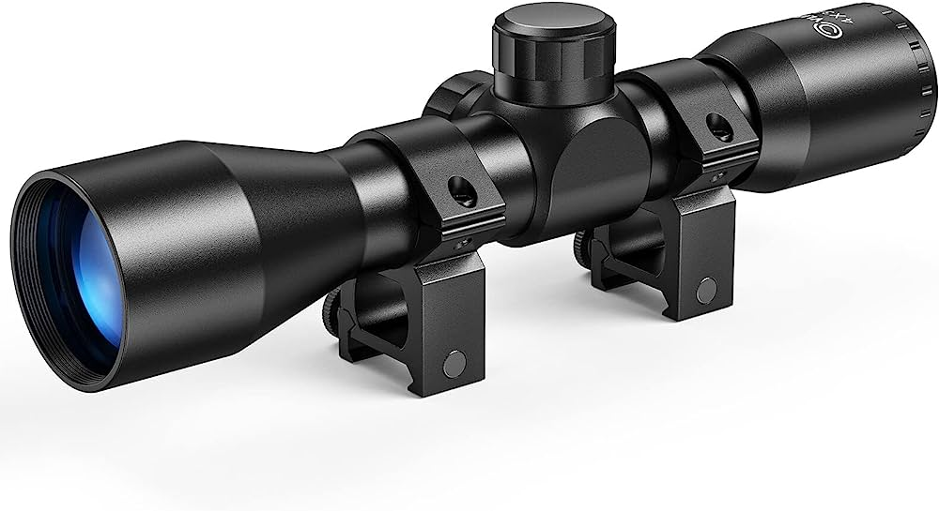
Project scope & features
Android application
Plane recognition
Placing objects
Image tracking

Slide 6

Technology stack
Unity
AR Core
Visual studio code

Slide 7
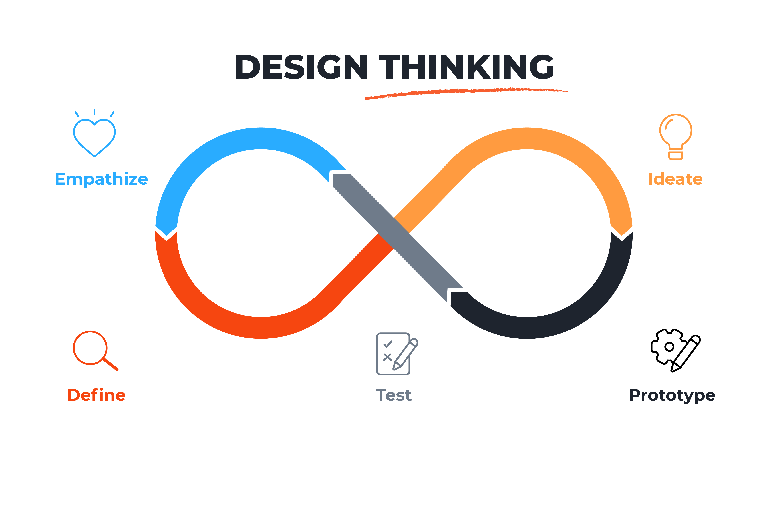
Design & development
Prototype
As minimalistic as possible

Slide 8
Demonstration
https://youtu.be/PpHPmu2LfCw

Slide 9
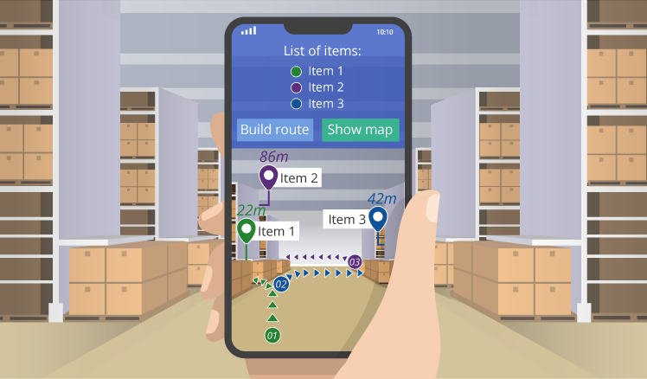
Future enhancements
Expand tracking ability
Pallets & specific packages
Menu to select packages for tracking
Room for expansion

Slide 10

What we improved on
Working with Unity
Working together
Building with AR
Writing better documentation

Slide 11

Lessons learned
Never trust nobody
Do not tackle projects without essential equipment

Slide 12

Conclusion ”Persistence leads to the achievement of even the most challenging goals.” ~Chatgpt 2023
Expect the unexpected
Learned to overcome obstacles
Have an android

Slide 13
Questions

